Slide 1
THE DATA PLATFORM TO MANAGE FUTURE MOBILITY ON CITY STREETS
Ai4Cities Phase 2 Presentation

Slide 2
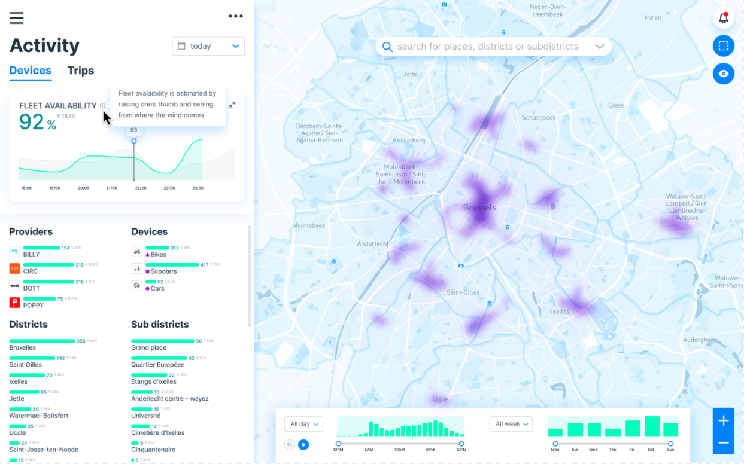
The Mobility Policy Auto-Tuner
Recommend to cities the optimal distributions of vehicles that would achieve the highest CO2 reduction when balanced against other priorities of the city
Ease the design of shared mobility policy requirements
Continuously assess the effectiveness of adopted policies in achieving CO2 reduction and other policy goals

Slide 3
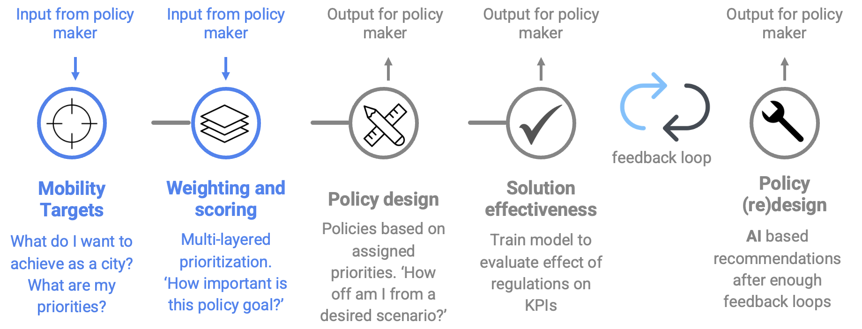
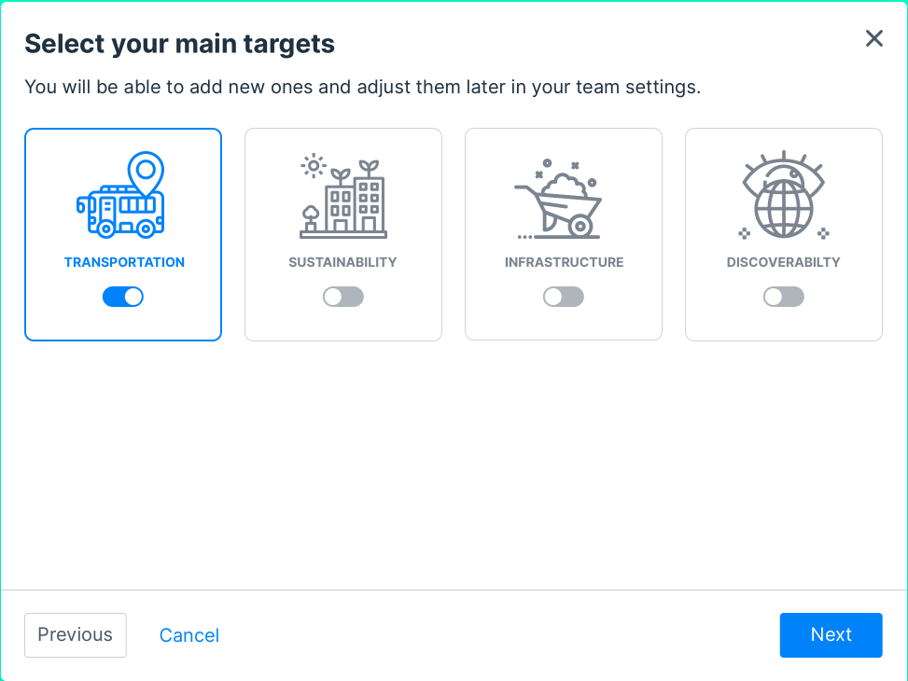
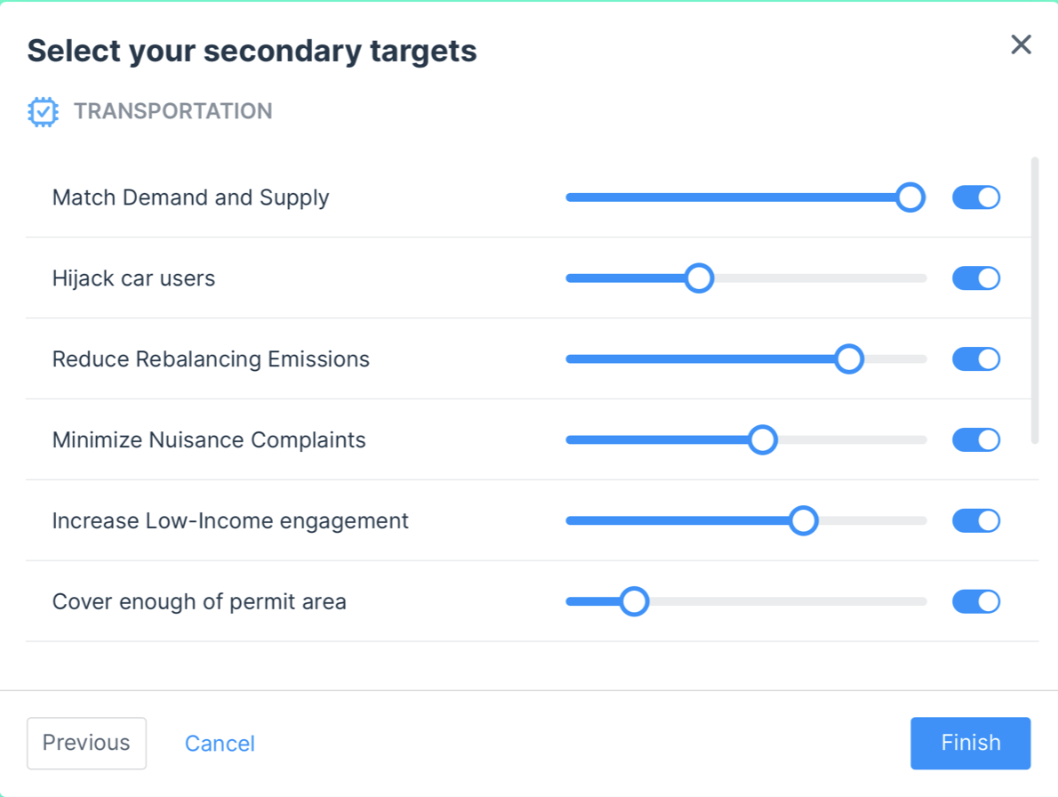
MPAT Workflow

Slide 4
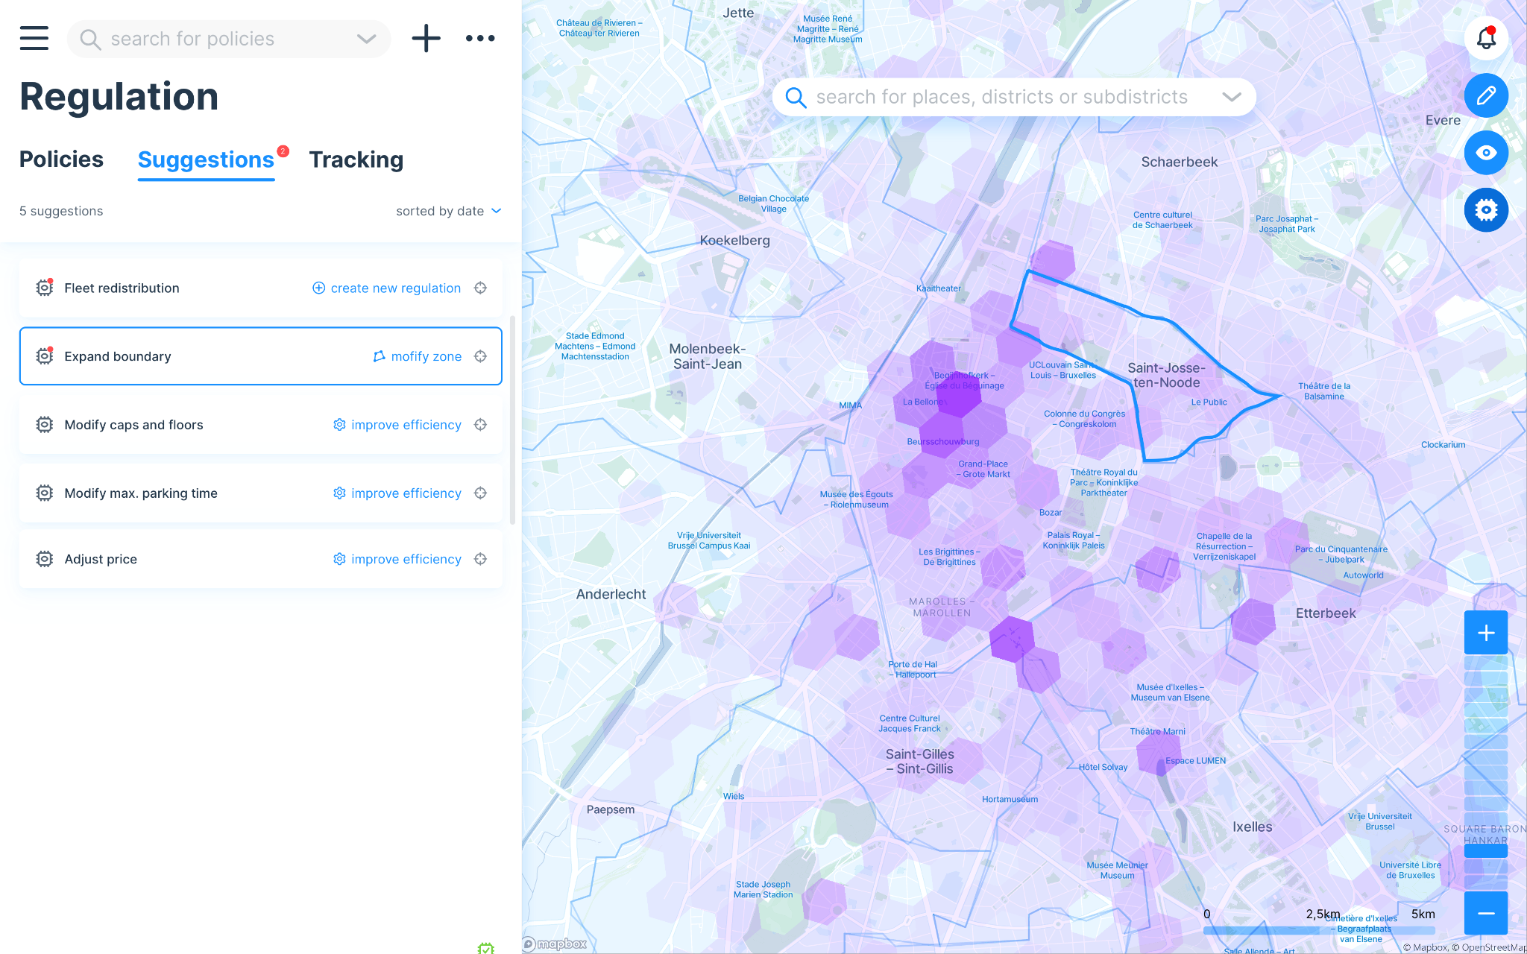
Feedback Loop to Maximize Goals

Slide 5
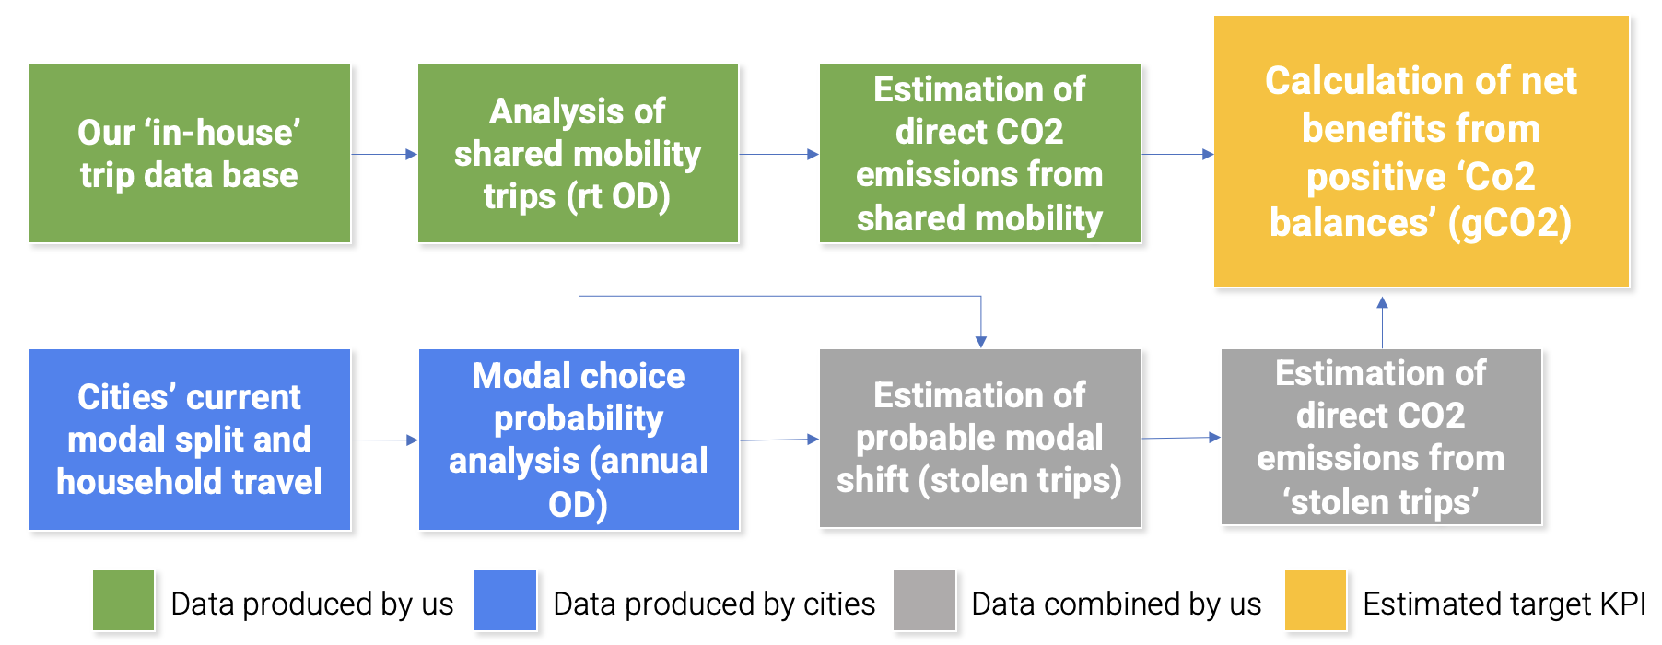
MPAT Data Sources

Slide 6
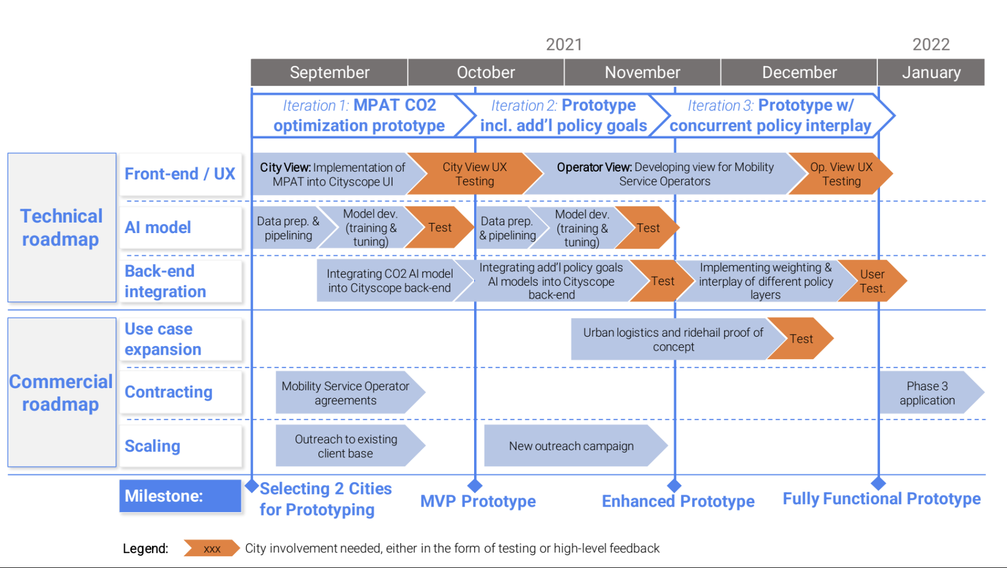
Workplan For Phase 2

