Slide 1
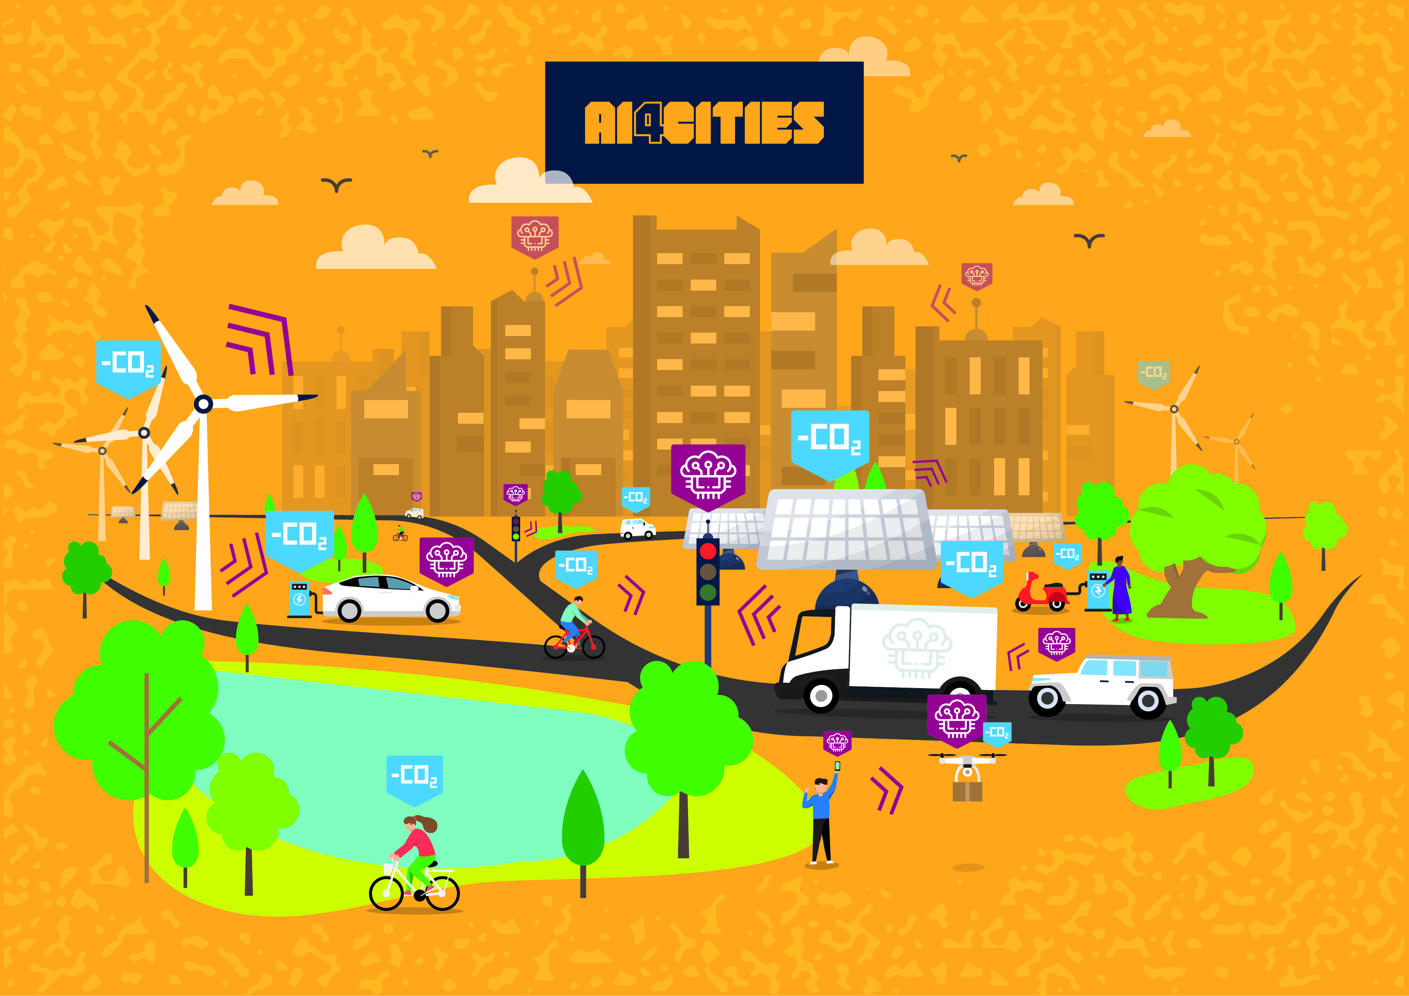
Accelerating carbon neutrality
Ai4Cities kick-off webinar Phase 2 Manuel Ceva, Insight SIgnals

Slide 2
AI4Cities pitch –introduction
Who we are
CEO, co-founder of Insight Signals
Insight Signals design and operate customized Digital Twins centered on the behaviors of consumers & users
Our solution
A user-centred Mobility Digital Twin
The sub challenges we are addressing
“Out of the box” , with a focus on:
Integrating mobility user’s behaviours into city investment decisions
Increasing projects’ scaling and CO2 reduction through project impact simulation
Providing cities with a holistic view of how mobility choices contribute to their Carbone neutrality goal
Which reproduces and simulates over time the transportation system of a city and calculates resulting CO2 emissions

Slide 3
AI4Cities pitch – Phase 2 plans
What we have learned from Phase 1
Strong market resonance but immaturity in terms of what a “Digital Twin” is about
Heterogeneity of data publicly available form one city to the others
Despite this a single cross city mobility model is feasible
Our plans for Phase 2
Develop a working Prototype of a Mobility Digital Twin
Further explore replication potential and conditions
Refine product definition & implementation methodology
Our main challenges
Define what could be included in a preliminary Prototype demo end of November vs a working Prototype 20th of January
Consolidate market development strategy and how to convince cities to buy it
A prototype will have to focus on one city example
A product that generates CO2 reduction indirecly

