Slide 1
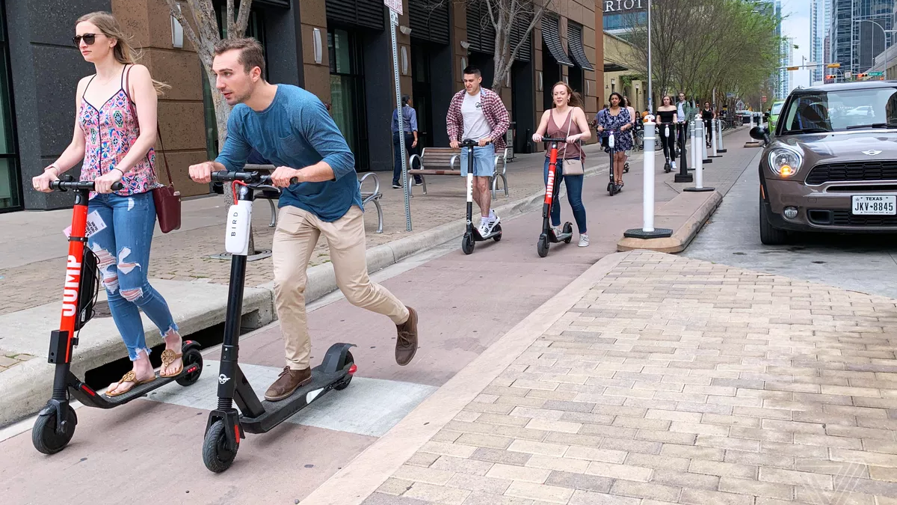
FutureUrbanMobility
How Location Intelligence can be used to optimize shared & active mobility modes in urban planning
This is part of the AI4Cities project that has received funding from the European Union’s Horizon 2020 Research and Innovation Programme under grant agreement No 871914.

Slide 2
Introductions
Luis Alcántara
Isabel Pozuelo
Project Manager
Business Strategy

Slide 3
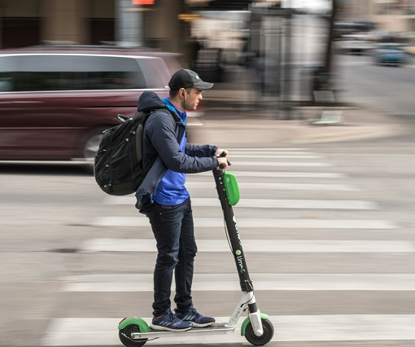
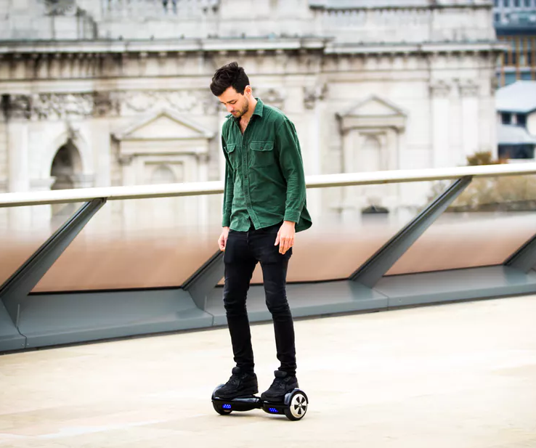
Micro & active mobility can reduce traffic congestion & CO2 emissions

Slide 4
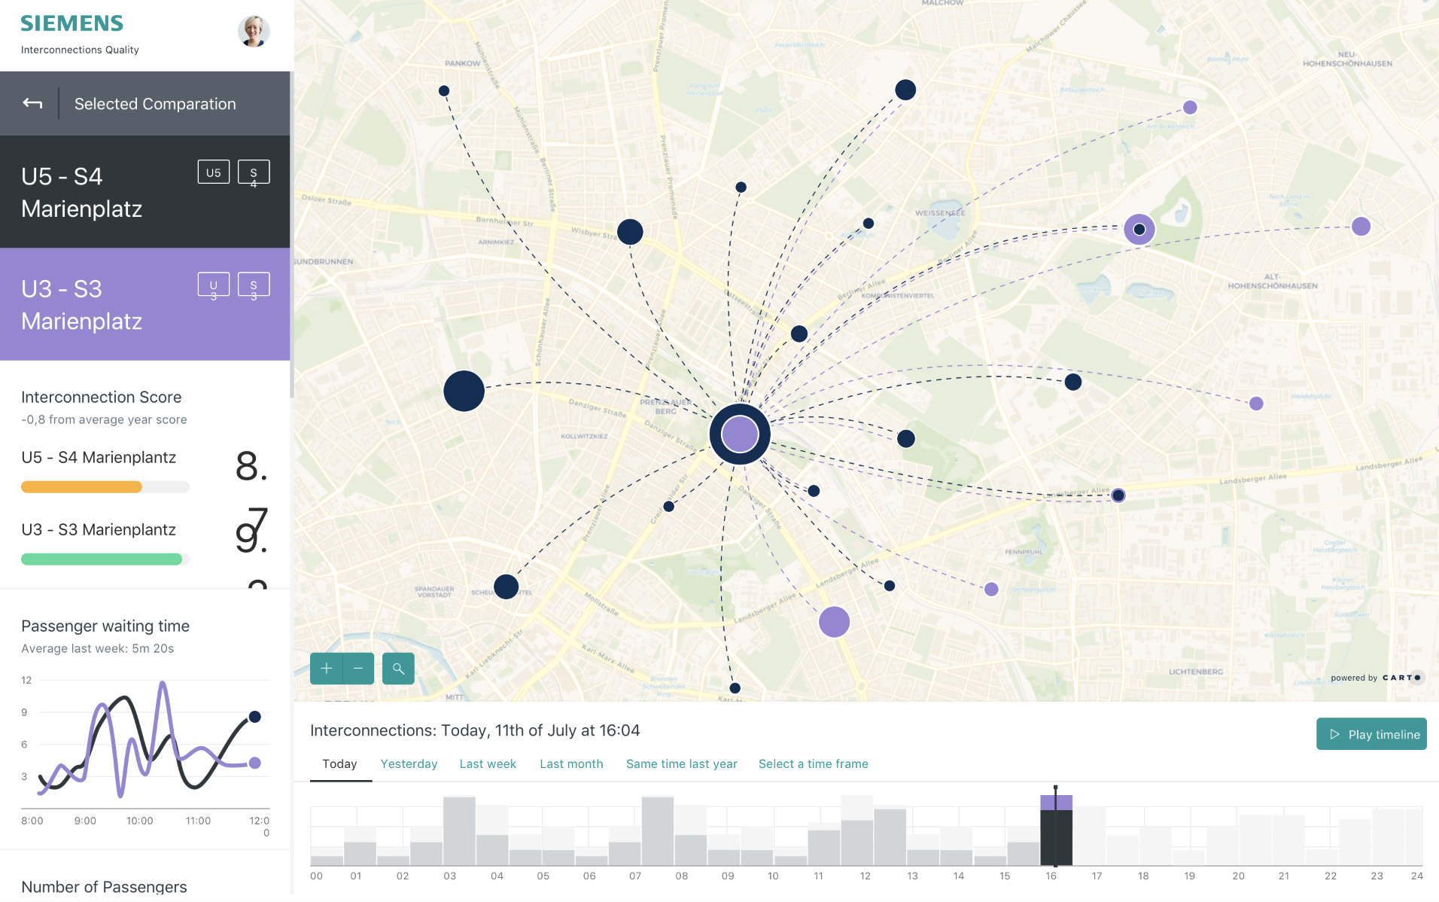
FutureUrbanMobility
A Location Intelligence solution to optimize shared & active mobility modes in urban planning based on Artificial Intelligence in the form of Machine Learning.

Slide 5
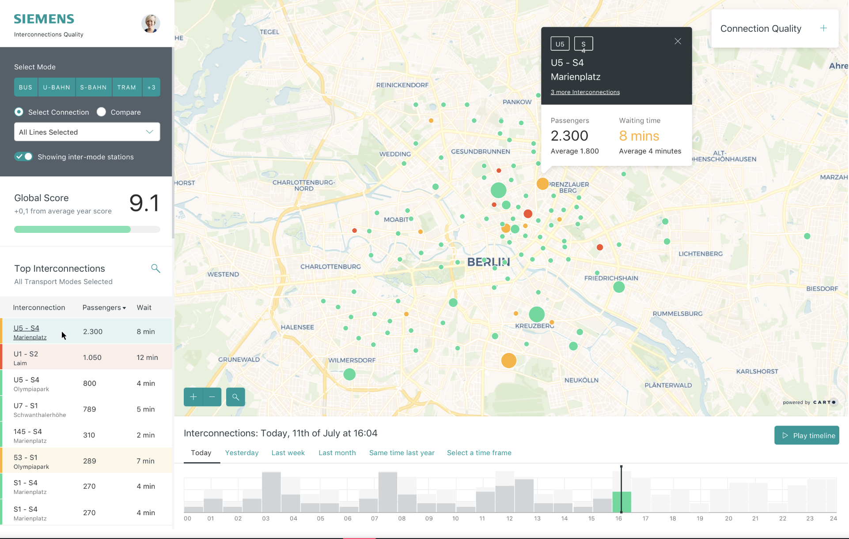
Demand analysis
Emissions prediction
Mobility
planning
Gamification & incentivization

Slide 6
Phase 2 - Plan for prototyping
Design
Data Science
Software development
Testing

Slide 7
Thanks !
For more info, contact lalcantara@carto.com or ipozuelo@carto.com
This is part of the AI4Cities project that has received funding from the European Union’s Horizon 2020 Research and Innovation Programme under grant agreement No 871914.

